Slide 1

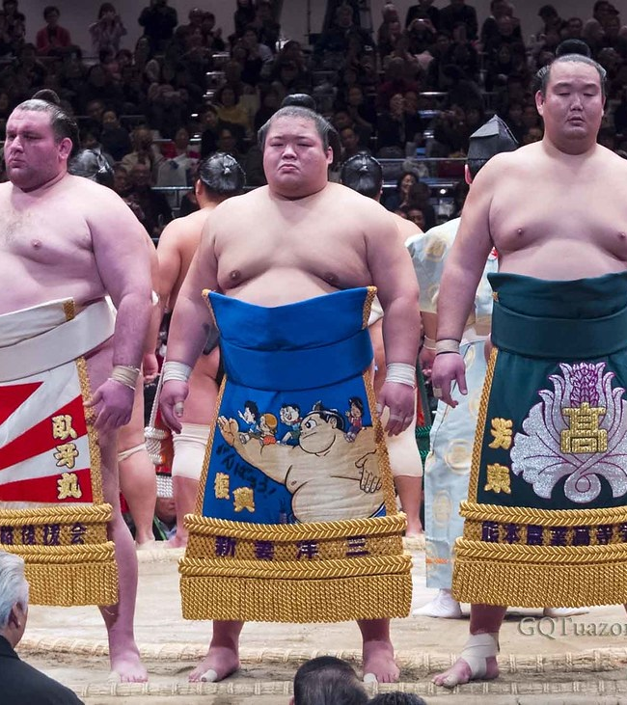
Rank-ishi
Sumo Wrestling and using Machine Learning to Predict Future Tournaments Results

Slide 2
Project Team
Melat Bekele
Ernesto Cancel
Ithamar Francois
Isabella Lehar
Tim Weir

Slide 3
Project Background and Objective:
Sumo originated in Japan and is the only country where it is practiced professionally. It has an old history and has many ritual elements. As with all sport betting, people want to find an advantage, even in Sumo sports betting. Our goal is to utilize machine learning and the previous win/loss results dataset to predict future tournament outcomes. We will use this historic data to predict the upcoming Tournament in July and to predict the wrestlers who will win and lose based on their personal previous results. Our goal is to see how accurately a machine can predict the outcomes of Sumo Wrestling which has a very human and unpredictable element to the sport.

Slide 4
Brief Project Outline
A. Quick cheat sheet on what Sumo is for the viewer
B. Visualizations on facts about Sumo including information on wrestlers
C. Dashboard that is interactive
Compare more than one wrestler
Top Wrestler information-Makuuchi (Top Sumo division contains ~41 wrestlers)
Overall Sumo comparisons such as physical characteristics such as age ( from their birth dates),weight, and height-how this may affect results
Machine Learn: Regression analysis: per wrestler or rank (TBD)
Show statistical values for top wrestlers

Slide 5
Brief Project Outline (Contin.)
D. Machine Learning for predicting outcome:
Take dataset from participant history to Mar 2021 for modeling the machine learning to predict May outcome and compare to actual results
May tournament already occurred so we can test our modeling for July
If this model works, we then can see how it runs for July
E. Comparison analysis from all the wrestlers of the Makuuchi division
F. Total wins for each, totals losses for each etc.
G. Website link to https://sumo.or.jp/EnSumoDataRikishi/search/search
Show the competitor information or comparison information
Ticket information for the tournament
Can link the Profile of a particular wrestler

Slide 6
Project Responsibility for Implementation
Load all data to database: Mongo/AWS for further data processing and cleaning
Clean data-filter for the top wrestlers to focus on them for machine learning modeling on historic data and future results
Prediction (modeling) analysis: test diff. models to see which works the best for our unique dataset:
Implement this machine learning model-should be able to predict ANY future results
Consider additional models that may give us better results
Creating concise and interesting website to showcase results-show additional visualizations and information on Sumo Wrestling

Slide 7
Citation/Website Information
Data set:
https://data.world/cervus/sumo-japan/workspace/file?filename=banzuke.csv
https://sumo.or.jp/EnSumoDataRikishi/search/search
Websites:
https://josh-sulkers.medium.com/building-a-sumo-wrestling-match-predictor-using-machine-learning-2ac95c5e20a3
https://www.szumo.hu/sumobeya/heyaaddress.html
https://sumo.or.jp/EnSumoDataSumoBeya/wrap/
Youtube Channels for additional info: Sumostew, Chris Sumo, Jason's All-Sumo Channel

